Slide 1
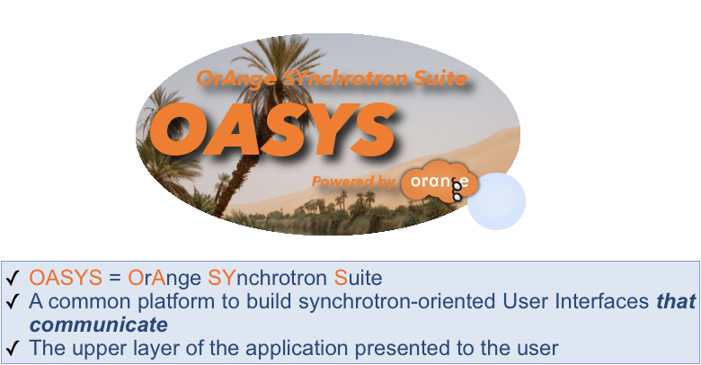
Introduction to OASYS
Luca Rebuffi (ANL)
Beamline Optics Design and Simulation Workshop
Hamburg, Germany
May 19-22, 2025
Notes:
Univ of Chicago Review, Aug. 30, 2010
1
Good morning, my name is Luca Rebuffi and I am staff member of the X-Ray Optics Group at the APS of the Argonne National Laboratory

Slide 2
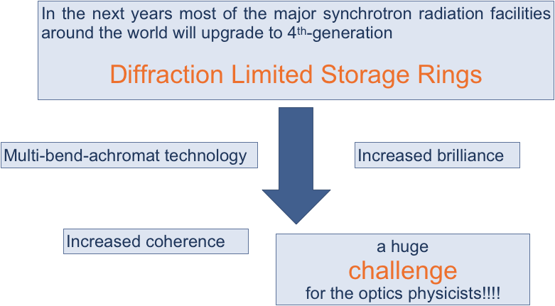
Introduction to OASYS – 12 years ago……

Slide 3
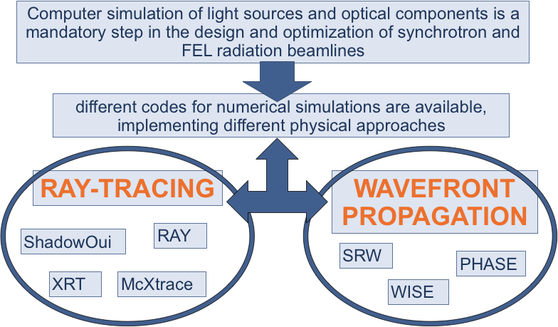
Introduction to OASYS – 12 years ago……

Slide 4
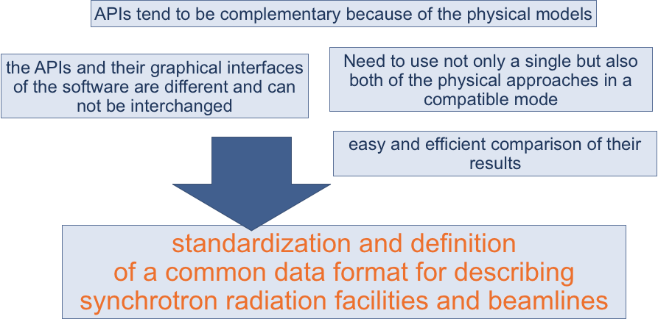
Introduction to OASYS – 12 years ago……

Slide 5
Introduction to OASYS – 12 years ago….
https://www.youtube.com/watch?v=XP1LJzRTdng

Slide 6
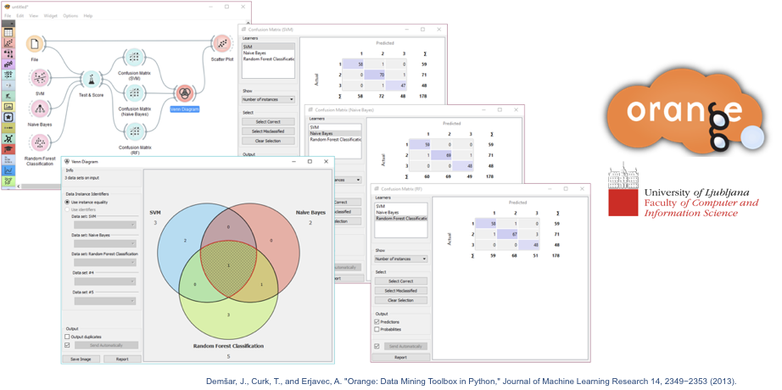
Introduction to OASYS

Slide 7
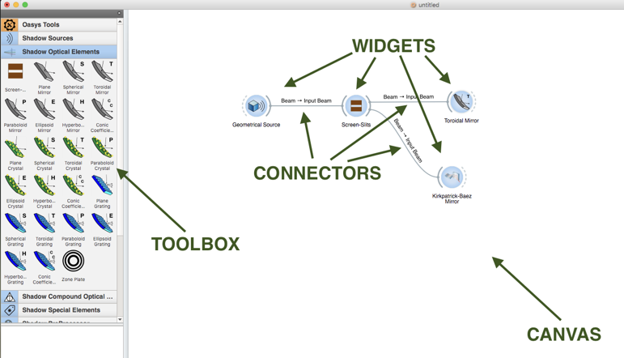
Introduction to OASYS

Slide 8
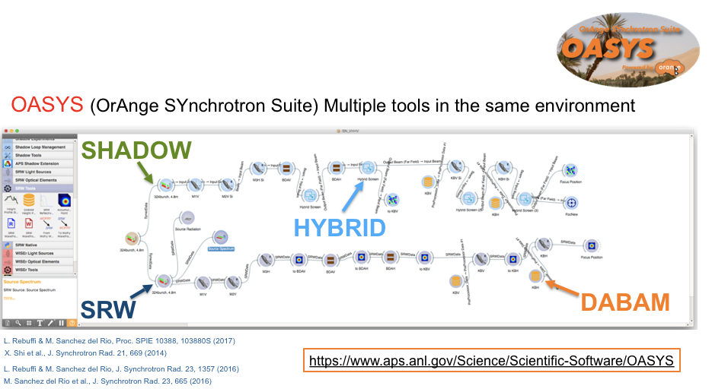
Introduction to OASYS

Slide 9
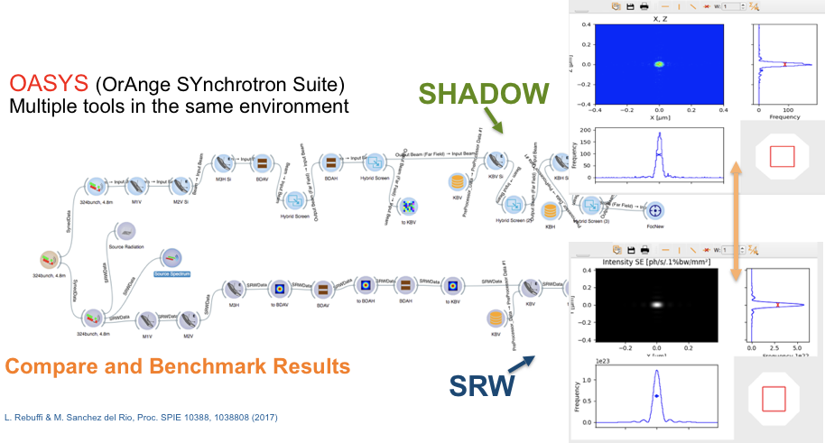
Introduction to OASYS

Slide 10
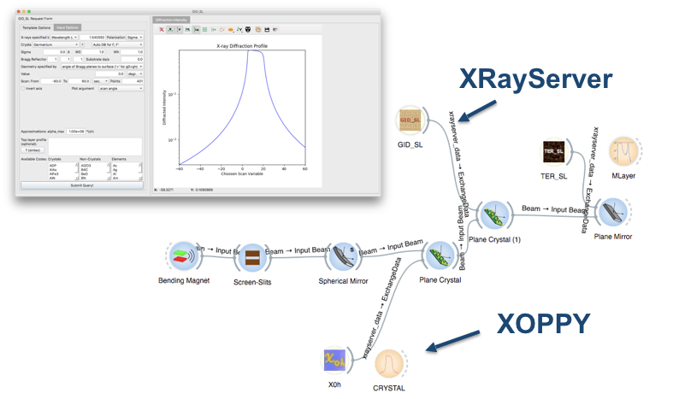
Introduction to OASYS
EASILY USE AND COMBINE WELL-KNOWN POWERFUL TOOL

Slide 11
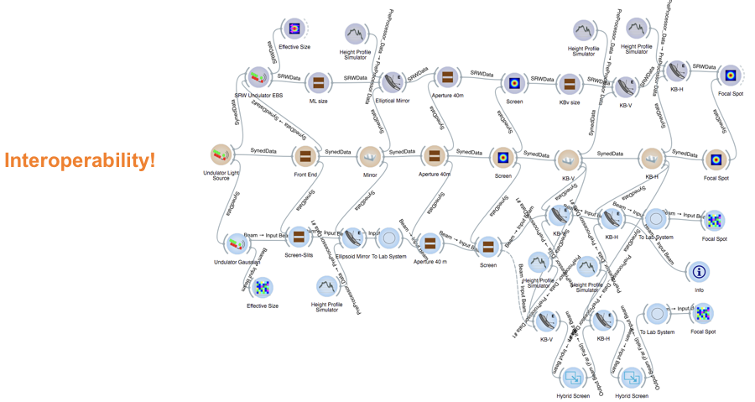
Introduction to OASYS

Slide 12
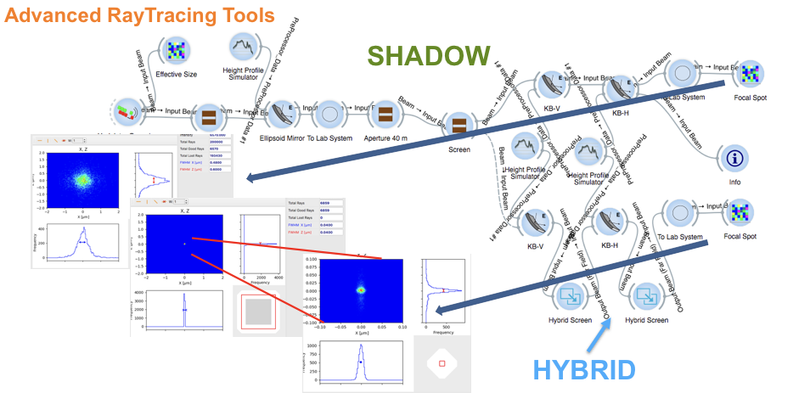
Introduction to OASYS

Slide 13
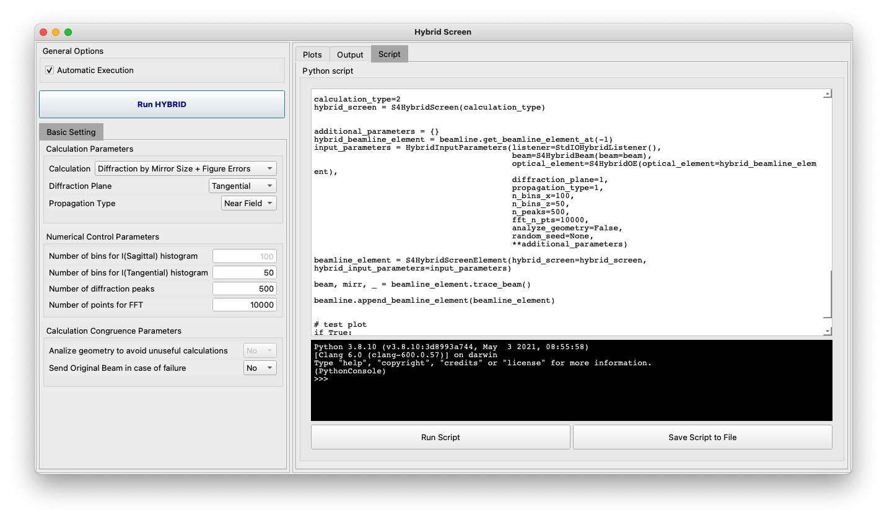
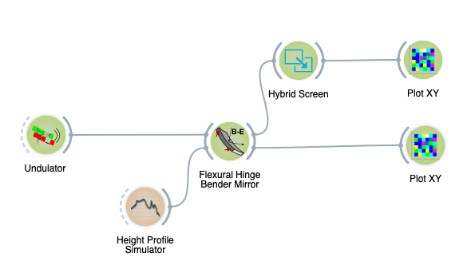
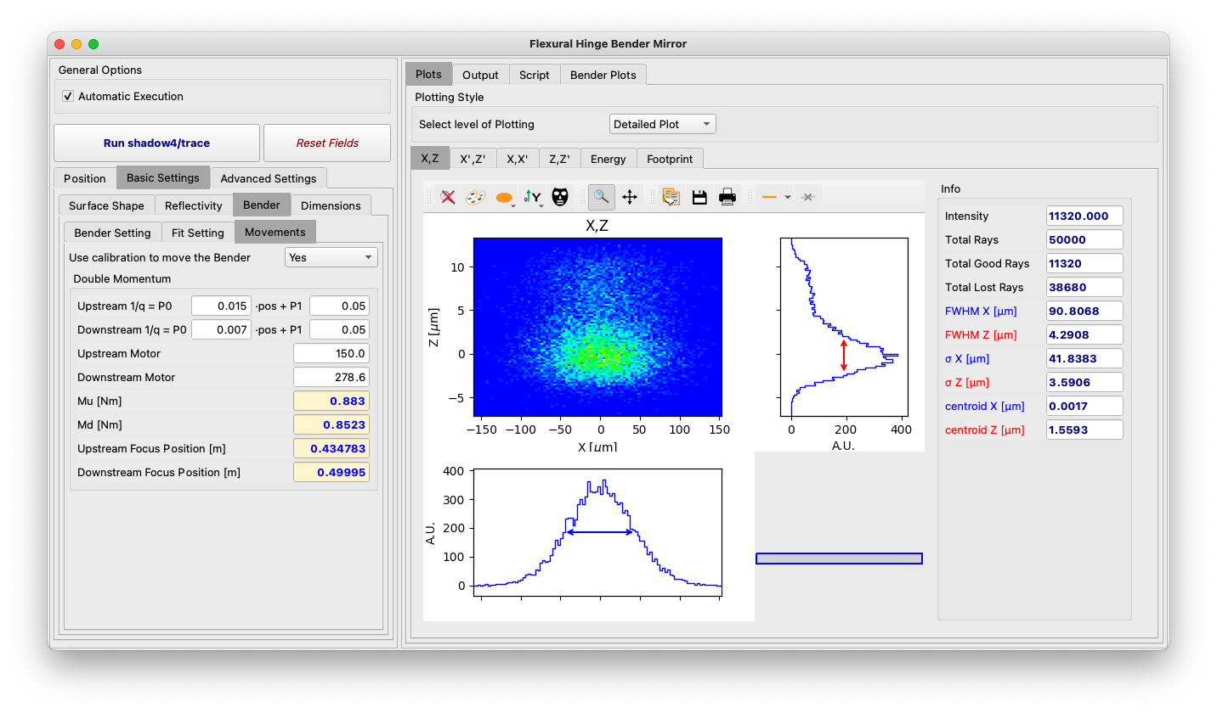
Introduction to OASYS
M. Sanchez del Rio, et al., “SHADOW4: the popular ray tracing revived for evolving synchrotron sources in fourth-generation storage rings ”, accepted for publication.
Advanced RayTracing Tools
SHADOW4: a revised and optimized new version of Shadow, fully implemented in python, including all the lesson learned in developing digital twins for the AI systems
Released August ‘24
Automatic generation of the corresponding python code, to be used by the optimizer
https://github.com/oasys-kit/shadow4
https://github.com/oasys-kit/shadow4-advanced

Slide 14
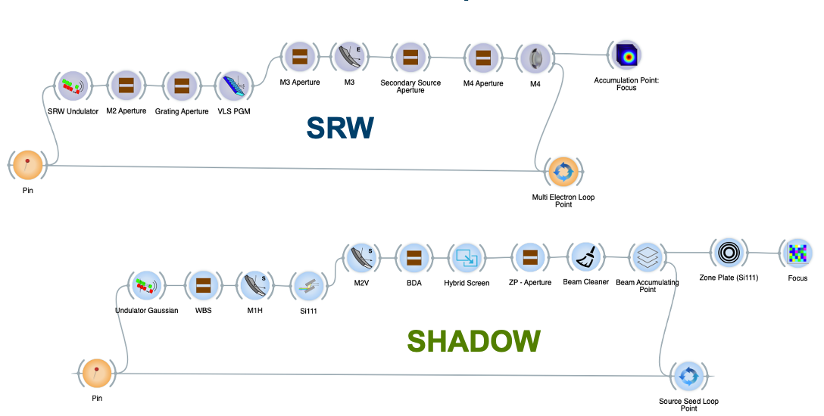
Introduction to OASYS
LOOPS

Slide 15
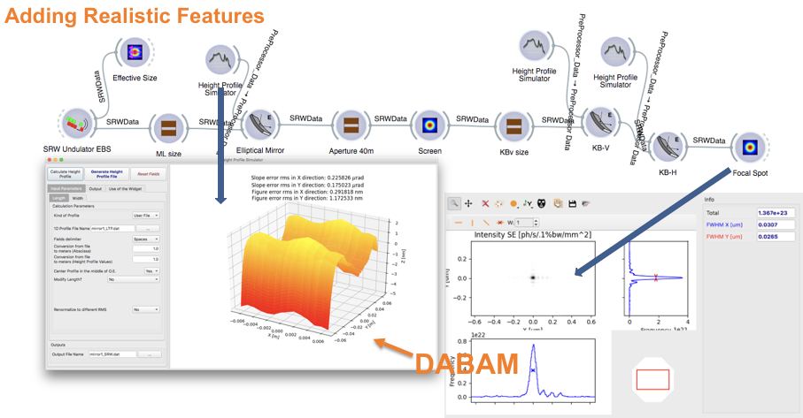
Introduction to OASYS
Surface Errors of Mirrors

Slide 16
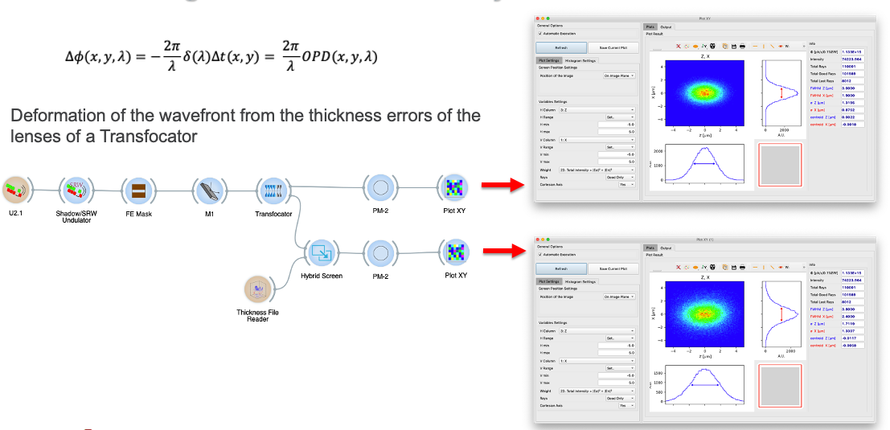
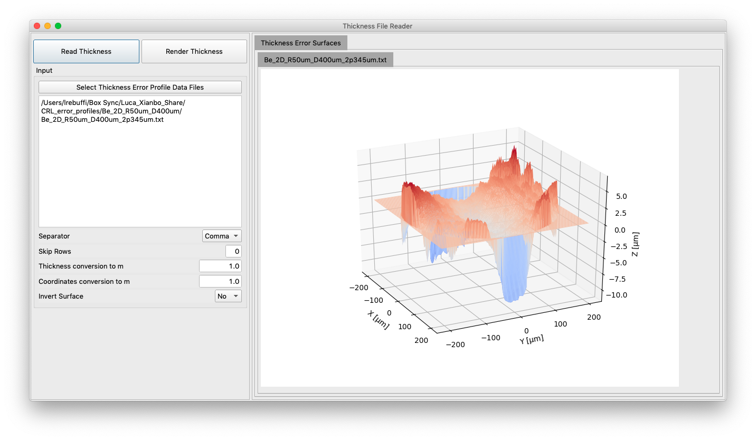
Introduction to OASYS
Thickness Error Profiles for CRLs

Slide 17
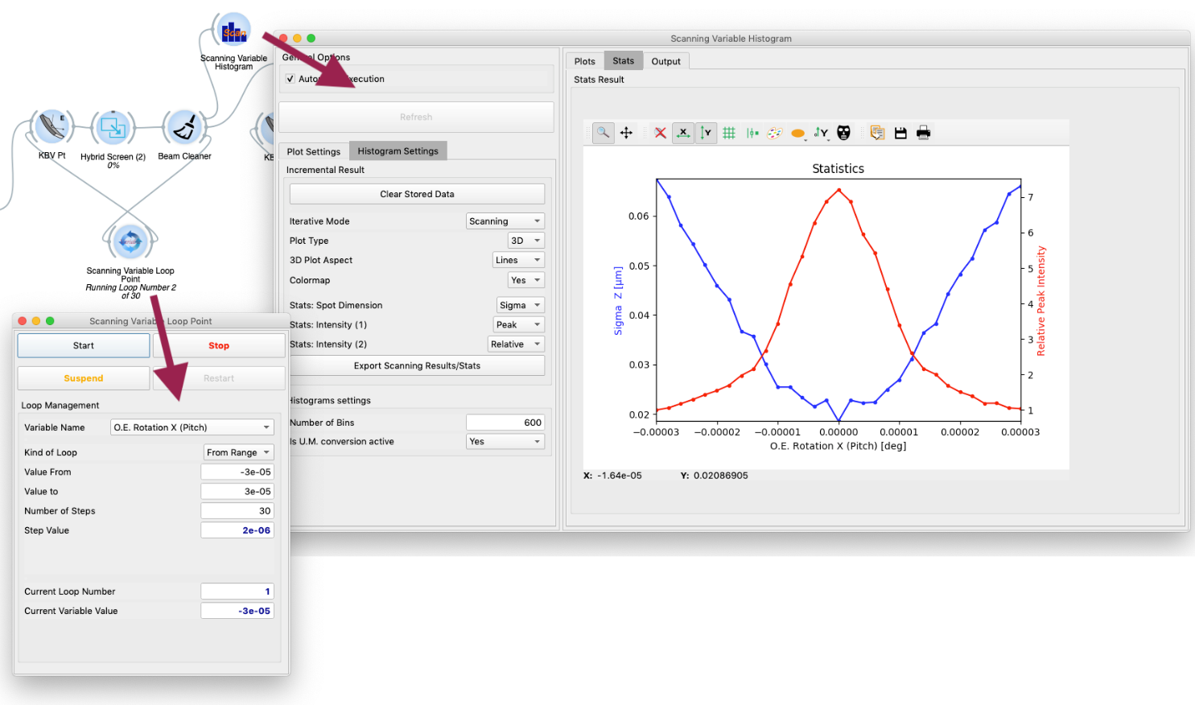
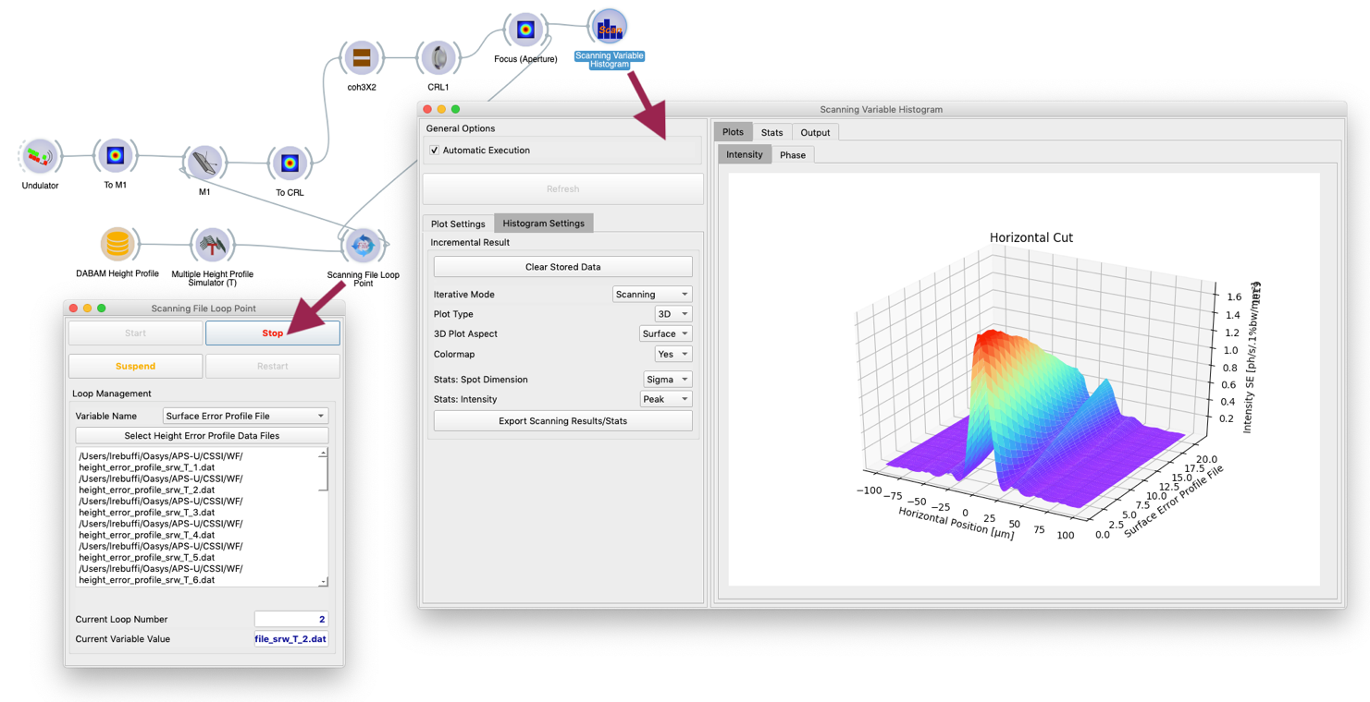
Introduction to OASYS
Advanced Loops for Optical Specifications

Slide 18
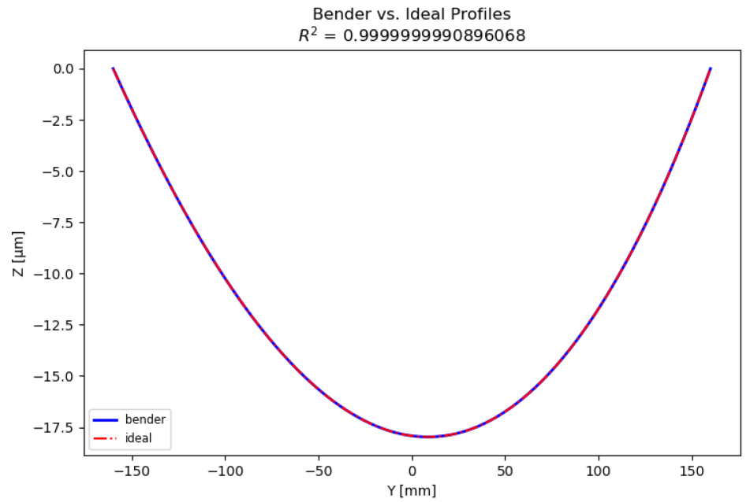
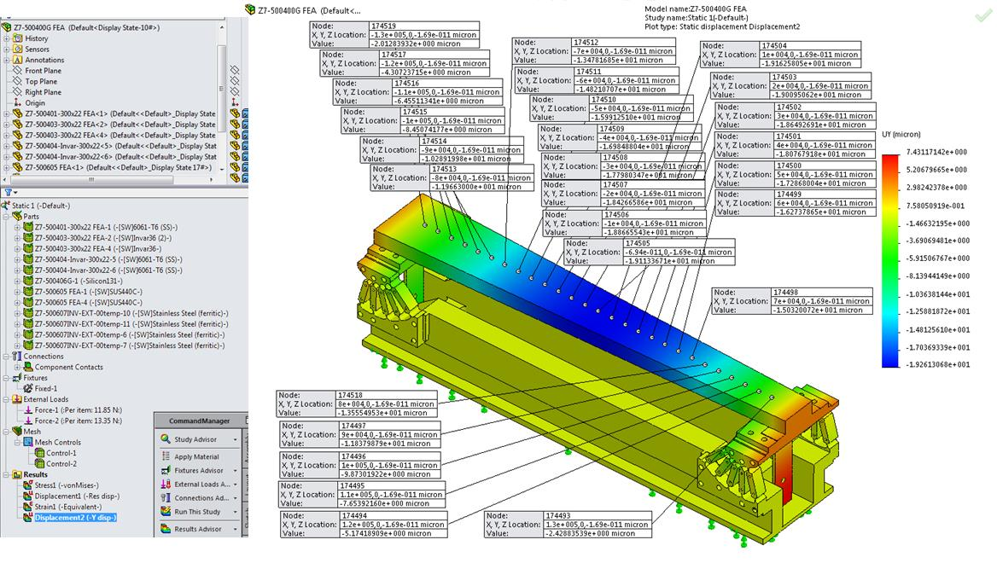
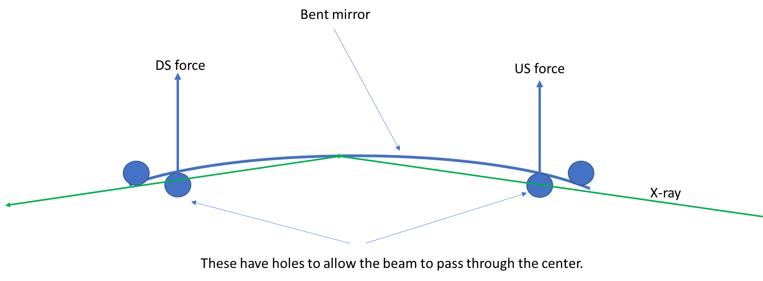
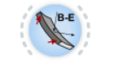
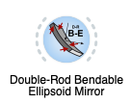
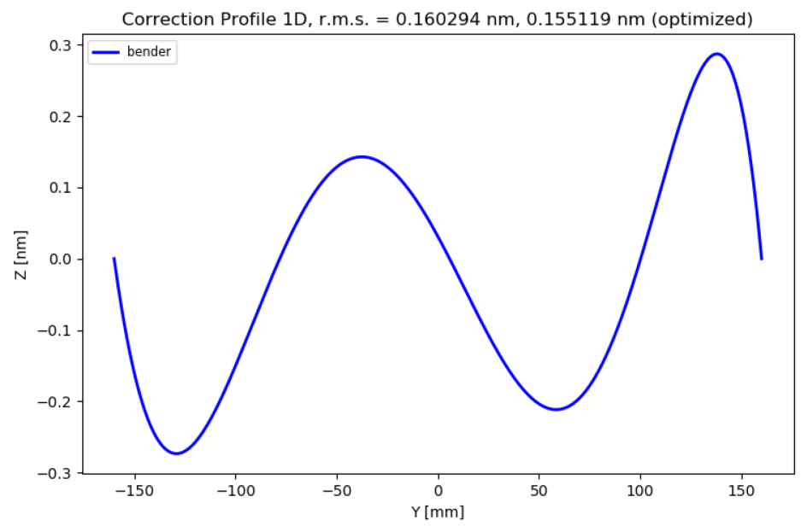
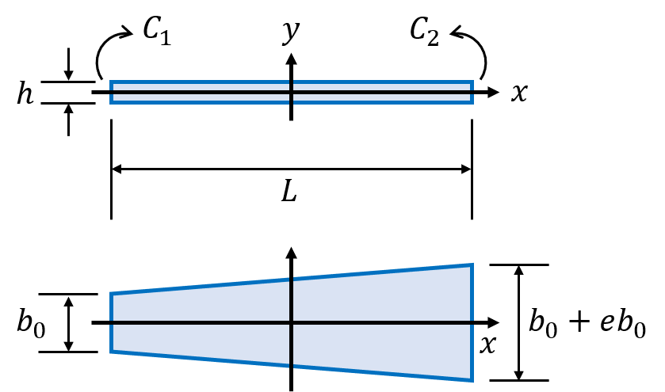
Introduction to OASYS
Simulation of realistic Mirrors
Bender vs Ideal profile
Bender error
Bendable Elliptical Mirror

Slide 19
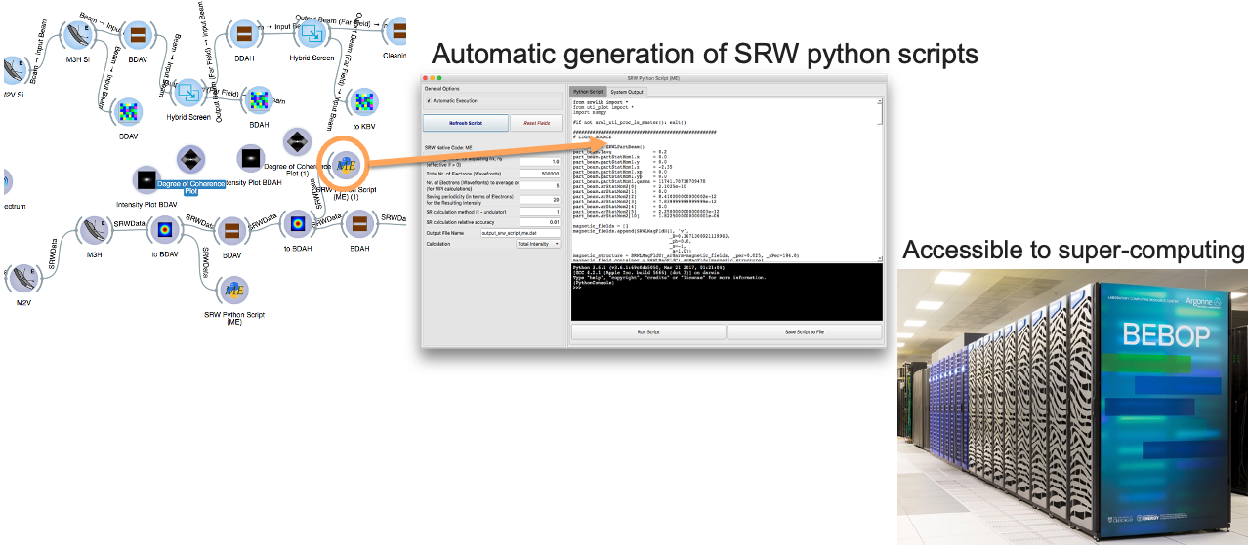
Introduction to OASYS

Slide 20
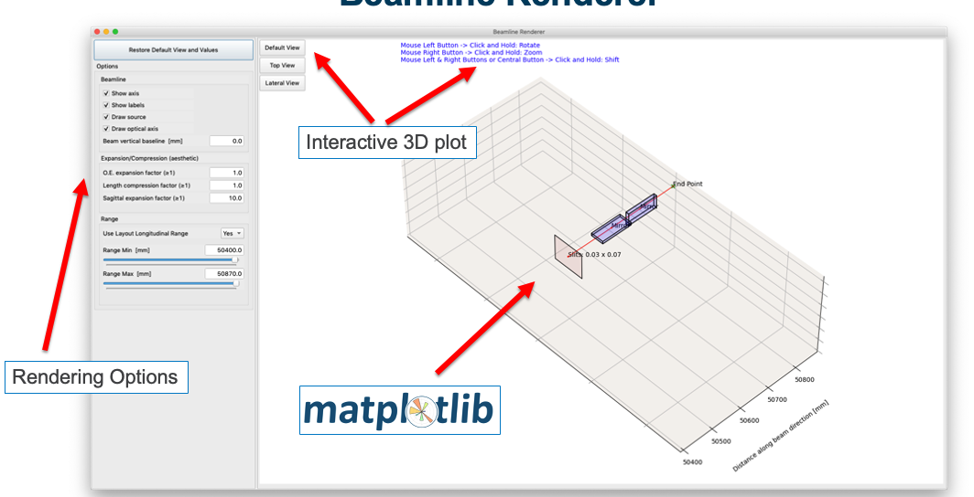
Introduction to OASYS
Beamline Rendering

Slide 21
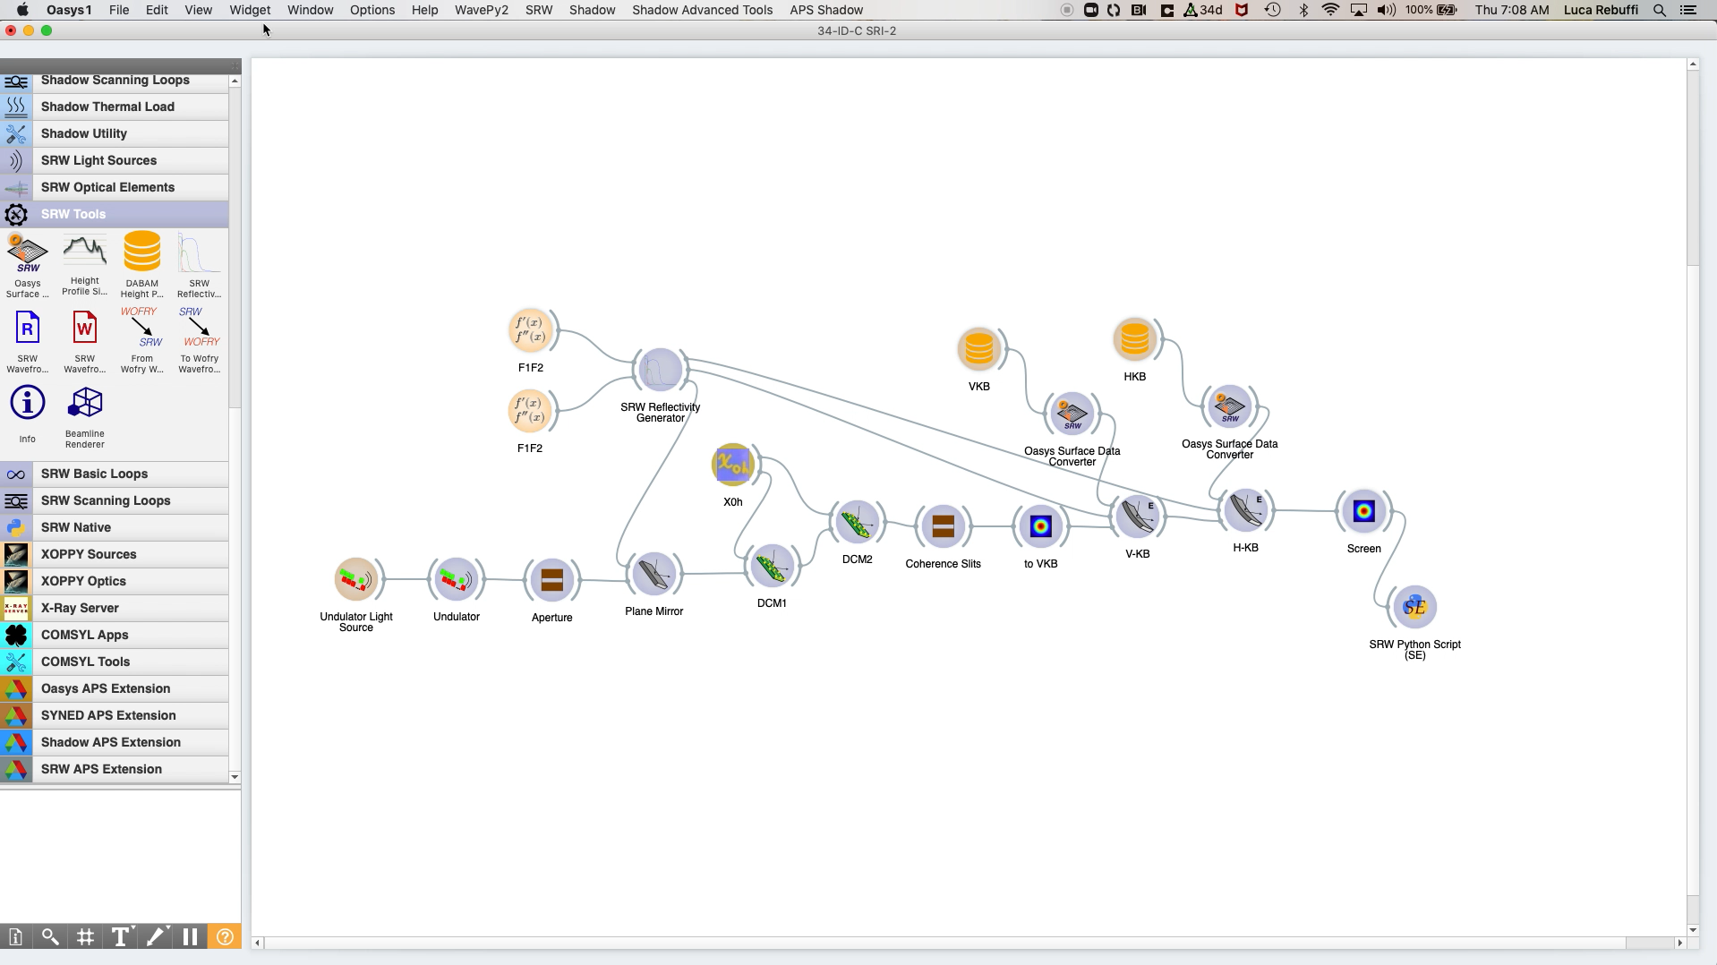
Introduction to OASYS

Slide 22
Thank you!

